Slide 1
Essentials of
Systems Analysis and Design
Sixth Edition
Joseph S. Valacich
Joey F. George
Jeffrey A. Hoffer
Chapter 7
Structuring System Requirements:
Conceptual Data Modeling
7.1

Slide 2
Learning Objectives
Define key data-modeling terms
  Conceptual data model
  Entity-Relationship (E-R) diagram
  Entity type
  Entity instance
  Attribute
  Candidate key
  Multivalued attributes
  Relationship
  Degree
  Cardinality
  Associative entity
7.2

Slide 3
Learning Objectives (continued)
Ask the right kinds of questions to determine data requirements for an IS
Learn to draw Entity-Relationship (ER) Diagrams
Review the role of conceptual data modeling in overall design and analysis of an information system
Distinguish between unary, binary and ternary relationships
Discuss relationships and associative entities
Discuss relationship between data modeling and process modeling
7.3

Slide 4
Conceptual Data Modeling
Representation of organizational data
Purpose is to show rules about the meaning and interrelationships among data
Entity-Relationship (E-R) diagrams are commonly used to show how data are organized
Main goal of conceptual data modeling is to create accurate E-R diagrams
Methods such as interviewing, questionnaires, and JAD are used to collect information
Consistency must be maintained among process flow, decision logic, and data modeling descriptions
7.4

Slide 5
The Process of Conceptual Data Modeling
First step is to develop a data model for the system being replaced
Next, a new conceptual data model is built that includes all the requirements of the new system
In the design stage, the conceptual data model is translated into a physical design
Project repository links all design and data modeling steps performed during SDLC
7.5

Slide 6
Deliverables and Outcome
Primary deliverable is the entity-relationship diagram
There may be as many as 4 E-R diagrams produced and analyzed during conceptual data modeling
  Covers just data needed in the project’s application
  E-R diagram for system being replaced
  An E-R diagram for the whole database from which the new application’s data are extracted
  An E-R diagram for the whole database from which data for the application system being replaced are drawn
7.6

Slide 7
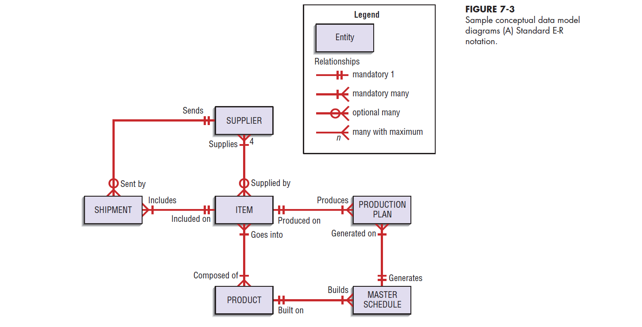
7.7

Slide 8
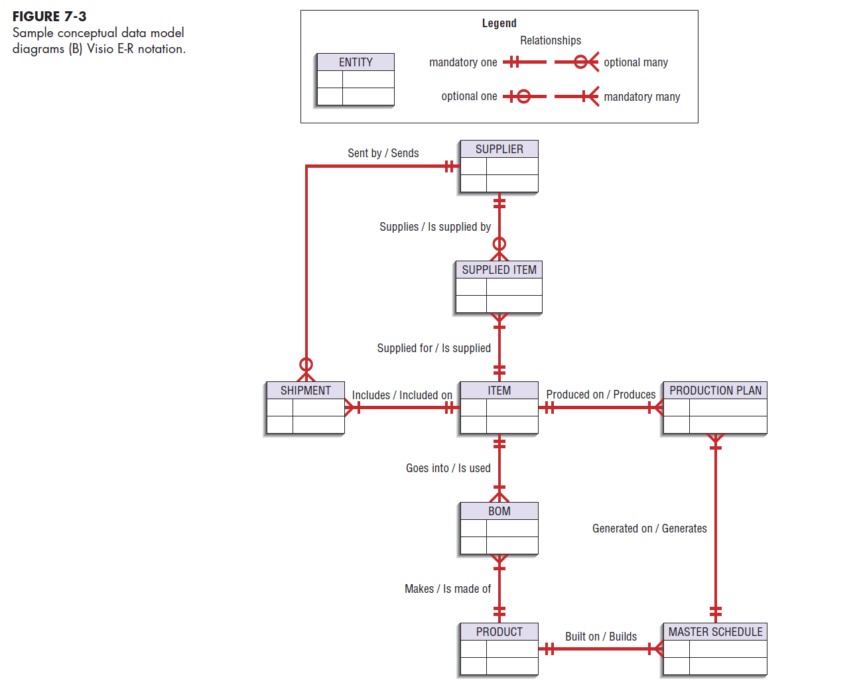
7.8

Slide 9
Deliverables and Outcome (continued)
Second deliverable is a set of entries about data objects to be stored in repository or project dictionary
  Data elements that are included in the DFD must appear in the data model and conversely
  Each data store in a process model must relate to business objects represented in the data model
7.9

Slide 10
Gathering Information for Conceptual Data Modeling
Two Perspectives:
  Top-down
    Data model is derived from an intimate understanding of the business
  Bottom-up
    Data model is derived by reviewing specifications and business documents
7.10

Slide 11
Introduction to Entity-Relationship Modeling
Notation uses three main constructs
  Data entities
  Relationships
  Attributes
Entity-Relationship (E-R) Diagram
  A detailed, logical, and graphical representation of the entities, associations and data elements for an organization or business
7.11

Slide 12
Entity-Relationship (E-R) Modeling
Key Terms
Entity
  A person, place, object, event or concept in the user environment about which the organization wishes to maintain data
  Represented by a rectangle in E-R diagrams
Entity Type
  A collection of entities that share common properties or characteristics
Entity Instance
  Single occurrence of an entity type
7.12

Slide 13
Entity-Relationship (E-R) Modeling (continued)
Key Terms
Attribute
  A named property or characteristic of an entity that is of interest to an organization
Candidate Keys and Identifiers
  Each entity type must have an attribute or set of attributes that distinguishes one instance from other instances of the same type
  Candidate key
    Attribute (or combination of attributes) that uniquely identifies each instance of an entity type
7.13

Slide 14
7.14

Slide 15
Entity-Relationship (E-R) Modeling (continued)
Key Terms
Identifier
  A candidate key that has been selected as the unique identifying characteristic for an entity type
  Selection rules for an identifier
    Choose a candidate key that will not change its value
    Choose a candidate key that will never be null
    Avoid using intelligent keys
    Consider substituting single value surrogate keys for large composite keys
7.15

Slide 16
Entity-Relationship (E-R) Modeling(continued)
Key Terms
Multivalued Attribute
  An attribute that may take on more than one value for each entity instance
  Represented on E-R diagram in two ways:
    double-lined ellipse
    weak entity
7.16

Slide 17
Entity-Relationship (E-R) Modeling (continued)
Key Terms
Relationship
  An association between the instances of one or more entity types that is of interest to the organization
  Association indicates that an event has occurred or that there is a natural link between entity types
  Relationships are always labeled with verb phrases
7.17

Slide 18
Conceptual Data Modeling and the E-R Diagram
Goal
  Capture as much of the meaning of the data as possible
Result
  A better design that is easier to maintain
7.18

Slide 19
Degree of Relationship
Degree
  Number of entity types that participate in a relationship
Three Cases:
  Unary
    A relationship between the instances of one entity type
  Binary
    A relationship between the instances of two entity types
  Ternary
    A simultaneous relationship among the instances of three entity types
    Not the same as three binary relationships
7.19

Slide 20
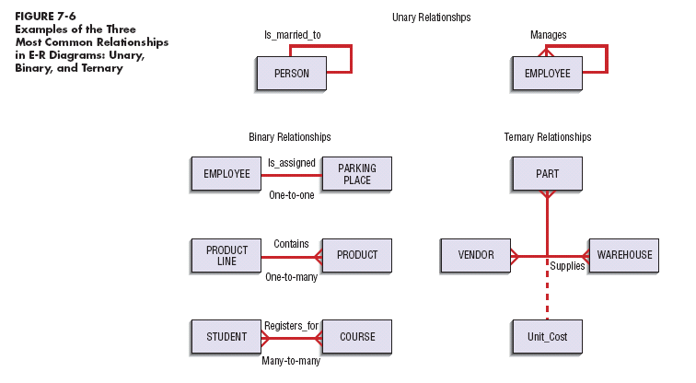
7.20

Slide 21
Cardinality
The number of instances of entity B that can be associated with each instance of entity A
Minimum Cardinality
  The minimum number of instances of entity B that may be associated with each instance of entity A
Maximum Cardinality
  The maximum number of instances of entity B that may be associated with each instance of entity A
7.21

Slide 22
Associative Entity
An entity type that associates the instances of one or more entity types and contains attributes that are peculiar to the relationship between those entity instances
7.22

Slide 23
7.23

Slide 24
PVF WebStore:
Conceptual Data Modeling
Conceptual data modeling for Internet applications is no different than the process followed for other types of applications
Pine Valley Furniture WebStore
  Four entity types defined
    Customer
    Inventory
    Order
    Shopping cart
7.24

Slide 25
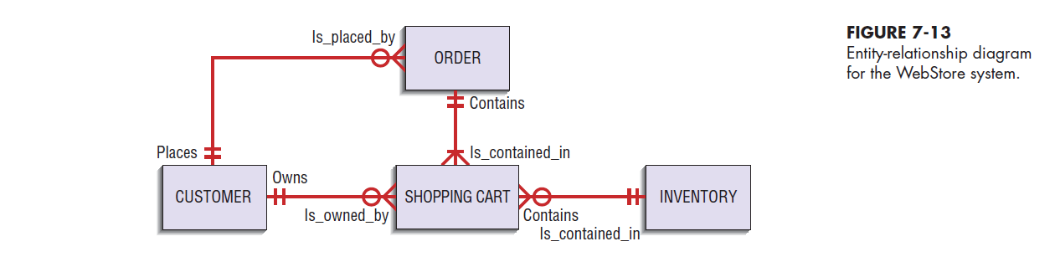
7.25

Slide 26
Selecting the Best Alternative Design Strategy
Two basic steps:
  Generate a comprehensive set of alternative design strategies
  Select the one design strategy that is most likely to result in the desired information system
Process:
  Divide requirements into different sets of capabilities
  Enumerate different potential implementation environments that could be used to deliver the different sets of capabilities
  Propose different ways to source or acquire the various sets of capabilities for the different implementation environments
7.26

Slide 27
Selecting the Best Alternative Design Strategy(continued)
Deliverables
  At least three substantially different system design strategies for building the replacement information system
  A design strategy judged most likely to lead to the most desirable information system
7.27

Slide 28
Generating Alternative Design Strategies
Best to generate three alternatives:
  Low-End
    Provides all required functionality users demand with a system that is minimally different from the current system
  High-End
    Solves problem in question and provides many extra features users desire
  Mid-range
    Compromise of features of high-end alternative with frugality of low-end alternative
7.28

Slide 29
Drawing Bounds on Alternative Designs
Minimum Requirements
  Mandatory features versus desired features
  Forms of features
    Data
    Outputs
    Analyses
    User expectations on accessibility, response time, and turnaround time
7.29

Slide 30
Drawing Bounds on Alternative Designs (continued)
Constraints on System Development:
  Time
  Financial
  Elements of current system that cannot change
  Legal
  Dynamics of the problem
7.30

Slide 31
Hoosier Burger’s New Inventory Control System
Replacement for existing system
Figure 7-15 ranks system requirements and constraints
7.31

Slide 32
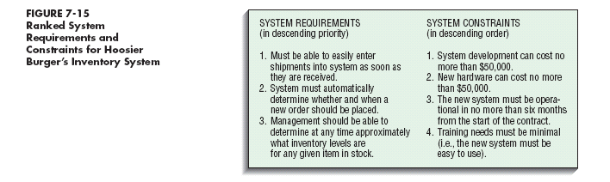
7.32

Slide 33
Hoosier Burger’s New Inventory Control System (continued)
Figure 7-16 shows steps of current system
When proposing alternatives, the requirements and constraints must be considered
7.33

Slide 34
7.34

Slide 35
Hoosier Burger’s New Inventory Control System (continued)
Figure 7-18 lists 3 alternatives:
  Alternative A is a low-end proposal
  Alternative C is a high-end proposal
  Alternative B is a mid-range proposal
7.35

Slide 36
Hoosier Burger’s New Inventory Control System (continued)
Selecting the Most Likely Alternative
  Weighted approach can be used to compare the three alternatives
  Figure 7-19 shows a weighted approach for Hoosier Burger
  Left-hand side of table contains decision criteria
    Constants and requirements
    Weights are arrived at by discussion with analysis team, users, and managers
  Each requirement and constraint is ranked
    1 indicates that the alternative does not match the request well or that it violates the constraint
    5 indicates that the alternative meets or exceeds requirements or clearly abides by the constraint
7.36

Slide 37
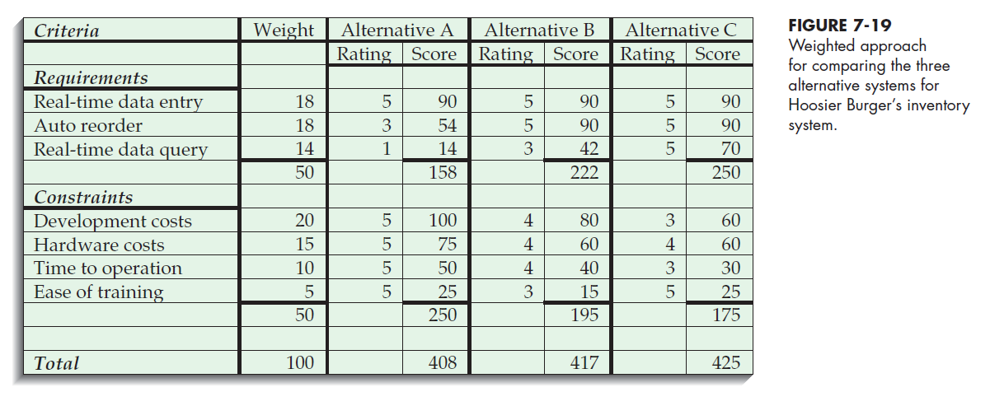
7.37

Slide 38
Hoosier Burger’s New Inventory Control System (continued)
Selecting the Most Likely Alternative
  According to the weights used, alternative C appears to be the best choice
7.38

Slide 39
Summary
Process of Conceptual Data Modeling
  Deliverables
  Gathering information
Entity-Relationship Modeling
  Entities
  Attributes
  Candidate keys and identifiers
  Multivalued attributes
Degree of Relationship
7.39

Slide 40
Summary (continued)
Cardinality
Associative Entities
Conceptual Data Modeling and Internet Development
Generating Alternative Design Strategies
7.40

Slide 41

All rights reserved. No part of this publication may be reproduced, stored in a retrieval system, or transmitted, in any form or by any means, electronic, mechanical, photocopying, recording, or otherwise, without the prior written permission of the publisher. Printed in the United States of America.
Copyright © 2015 Pearson Education, Inc.
Publishing as Prentice Hall

